Slide 1
GEEK AI MANIA’18

Slide 2

PROBLEM STATEMENT - 2
DETECTING THE
ANOMALY OF
HUMAN MOVEMENTS

Slide 3
FRAME CLASSIFICATION
Videos are first segmented into frames using opencv.
Features are extracted from each frame with help of VGG NET.
Each scene was split into various clips around 200 frames.
Each frame has 158 x 238 resolution.
Splitting each frame into 7 x 7 local patches with 4 pixel overlapping.

Slide 4
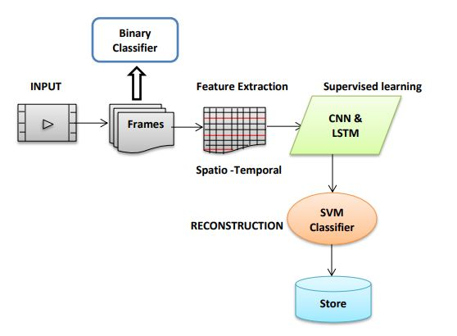
TRAINING DATASET
Normal videos are used for training
CNN used for learning spatial features
LSTM used for learning temporal features
It uses Supervised learning

Slide 5
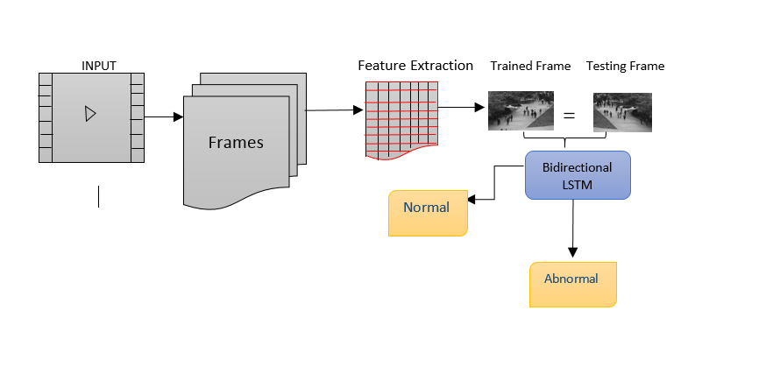
Testing dataset
It uses Semi-Supervised learning
Sparsity Reconstruction Cost(SRC) is used to measure the abnormal event detection in testing samples

Slide 6
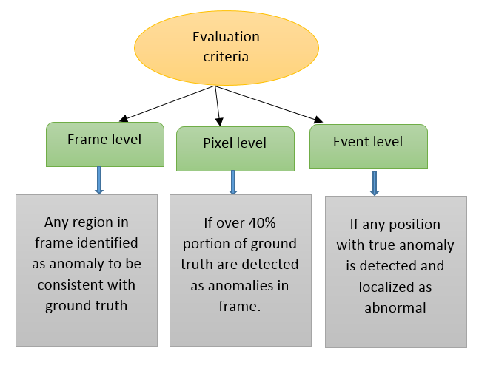
EVALUATION CRITERIA
QUANTITATIVE EVALUATION
True positive rate and false positive rate is found for ROC curve
Event error rate(EER) should be less and area under curve(AUC) should be more for better performace

Slide 7

Algorithms used
ALGORITHM | PURPOSE
Convolutional neural network | Image classification
Bidirectional LSTM | Sequential long term memory
SVM classifiers | Classification of frames
Dictionary learning | Minimize size and discard redundant
Sparse reconstruction cost | Quantify the normalness of testing data
K-NN learning | Measures similarities between training and testing samples
Deep learning algorithms are implemented using Keras library with backend Tensorflow.

Slide 8
THANK YOU!

